Slide 1
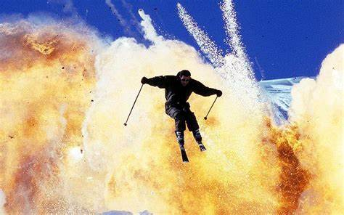
Dynamic panel data models
Felipe Buchbinder

Slide 2


This class in 2 sentences
A dynamic panel data model is one where $y_{it}$ depends on passed values of $y_{i.}$, such as $y_{it−1},y_{it−2}$ etc.
When this happens, $β$ can be estimated using the Arellano-Bond (AB) GMM estimator.

Slide 3
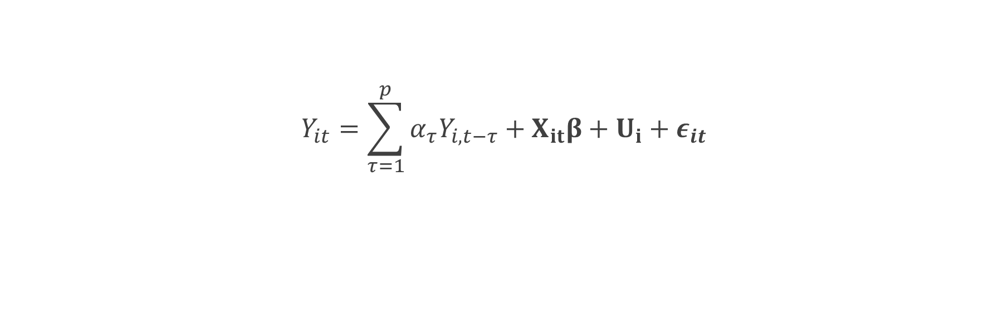
Dynamic Panel models (general equation)
$$Y_{it}=\sum_{τ=1}^{p}{α_{τ}Y_{i,t−τ}}+X_{it}β+U_{i}+ε_{it} \\ Y_{it}=αY_{i,t−1}+X_{it}β+U_{i}+ε_{it}$$

Slide 4
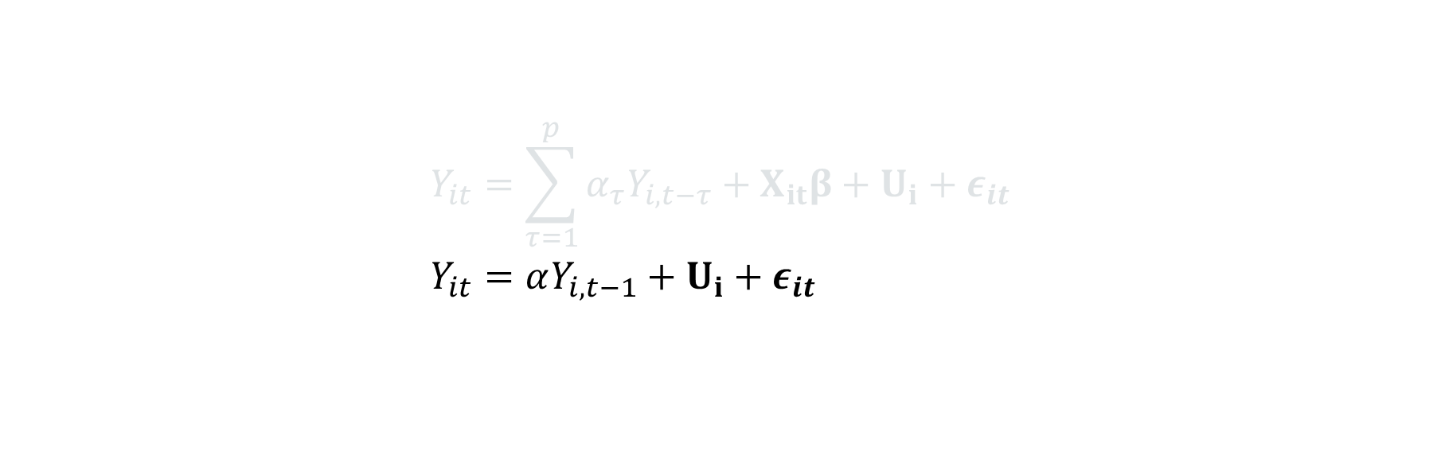
Dynamic Panel models (Simplest case possible: 1 lag, no covariates)
$$Y_{it}=\sum_{τ=1}^{p}{α_{τ}Y_{i,t−τ}}+X_{it}β+U_{i}+ε_{it} \\ Y_{it}=αY_{i,t−1}+U_{i}+ε_{it}$$

Slide 5


Let’s Try fixed effects…
$\ddot{Y_{it}}=α{\ddot{Y}}_{i,t−1}+{\ddot{ε}}_{it}$

Slide 6
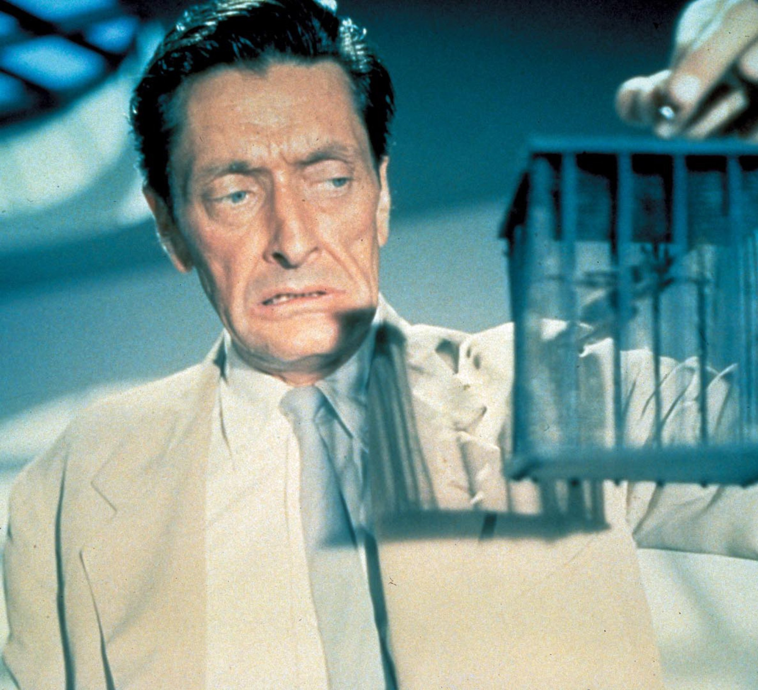
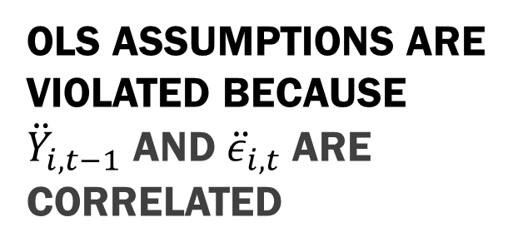

OLS assumptions are violated because ${\ddot{Y}}_{i,t−1}$ and ${\ddot{ε}}_{i,t}$ are correlated
$Y_{it−1}$ correlates with $ε_{it−1}$ thus with $\overline{ε_{i}}$ and finally with $ε_{it}−{\overline{ε}}_{i}$, This means $Y_{it−1}−{\overline{Y}}_{i}$ correlates with $ε_{it}−{\overline{ε}}_{i}$, and this violates the assumptions of linear regression.

Slide 7
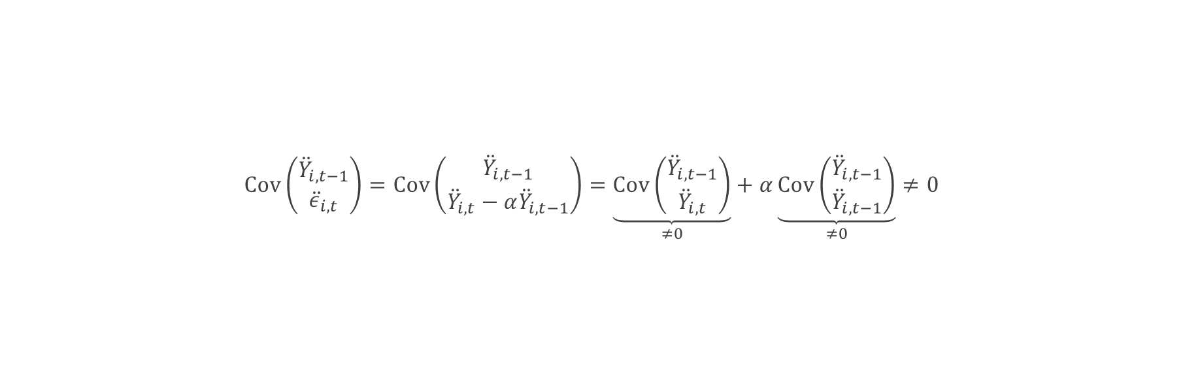
Proof
$$Cov\left(\begin{aligned}{\ddot{Y}}_{i,t−1} \\ {\ddot{ε}}_{i,t}\end{aligned}\right)=Cov\left(\begin{aligned}{\ddot{Y}}_{i,t−1} \\ {\ddot{Y}}_{i,t}−α{\ddot{Y}}_{i,t−1}\end{aligned}\right)=\underset{≠0}{\underbrace{Cov\left(\begin{aligned}{\ddot{Y}}_{i,t−1} \\ {\ddot{Y}}_{i,t}\end{aligned}\right)}}+α\underset{≠0}{\underbrace{Cov\left(\begin{aligned}{\ddot{Y}}_{i,t−1} \\ {\ddot{Y}}_{i,t−1}\end{aligned}\right)}}≠0$$
$$\ddot{Y_{it}}=α{\ddot{Y}}_{i,t−1}+{\ddot{ε}}_{it}$$

Slide 8

Perhaps you have better luck with first differences, Mr. Bond?
$$Δ_{t}Y_{it}=αΔ_{t}Y_{it−1}+Δ_{t}ε_{it}$$

Slide 9
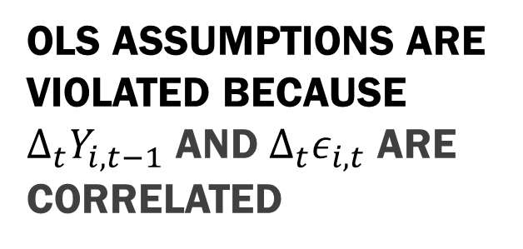

OLS assumptions are violated because ${Δ_{t}Y}_{i,t−1}$ and $Δ_{t}ε_{i,t}$ are correlated
$Δ_{t}Y_{it−1}$ correlates with $Y_{it−1}$ thus with $ε_{it−1}$ and finally with $Δ_{t}ε_{it}$.

Slide 10
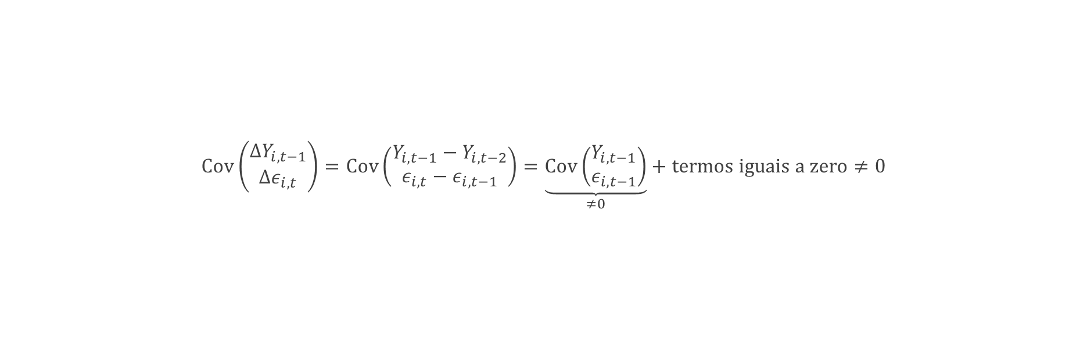
Proof
$$Cov\left(\begin{aligned}{ΔY}_{i,t−1} \\ {Δε}_{i,t}\end{aligned}\right)=Cov\left(\begin{aligned}Y_{i,t−1}−Y_{i,t−2} \\ ε_{i,t}−ε_{i,t−1}\end{aligned}\right)=\underset{≠0}{\underbrace{Cov\left(\begin{aligned}Y_{i,t−1} \\ ε_{i,t−1}\end{aligned}\right)}}+termos iguais a zero≠0$$

Slide 11

How about we find an instrumental variable for this problem?

Slide 12

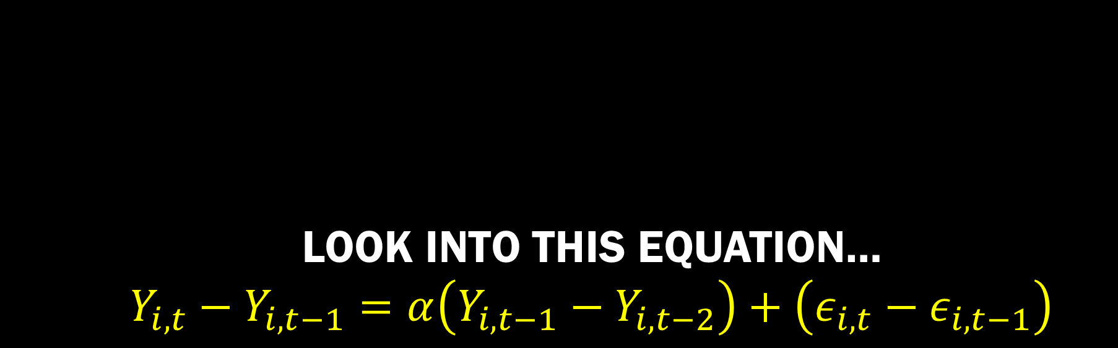
Look into this equation… $$Y_{i,t}−Y_{i,t−1}=α\left(Y_{i,t−1}−Y_{i,t−2}\right)+\left(ε_{i,t}−ε_{i,t−1}\right)$$

Slide 13

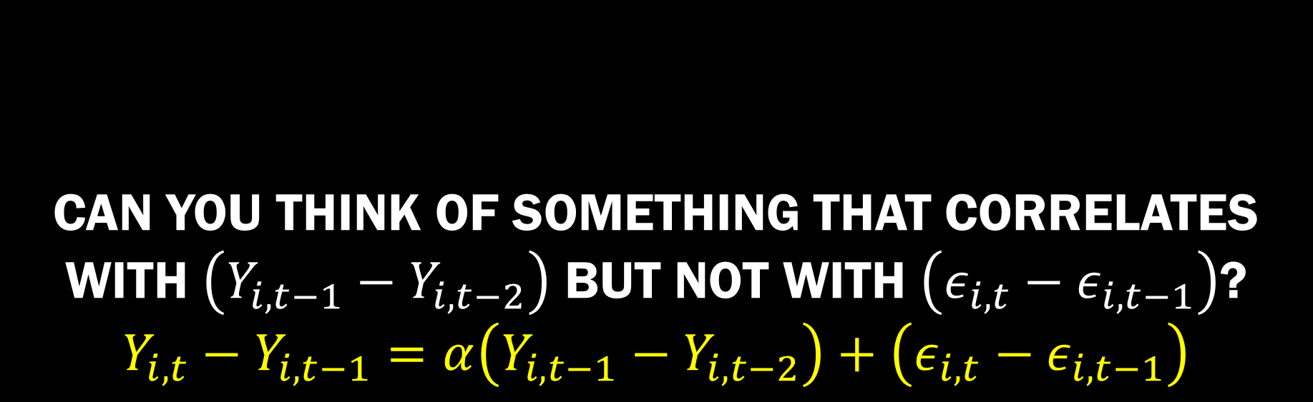
Can you think of something that correlates with $\left(Y_{i,t−1}−Y_{i,t−2}\right)$ but not with $\left(ε_{i,t}−ε_{i,t−1}\right)$? $$Y_{i,t}−Y_{i,t−1}=α\left(Y_{i,t−1}−Y_{i,t−2}\right)+\left(ε_{i,t}−ε_{i,t−1}\right)$$

Slide 14
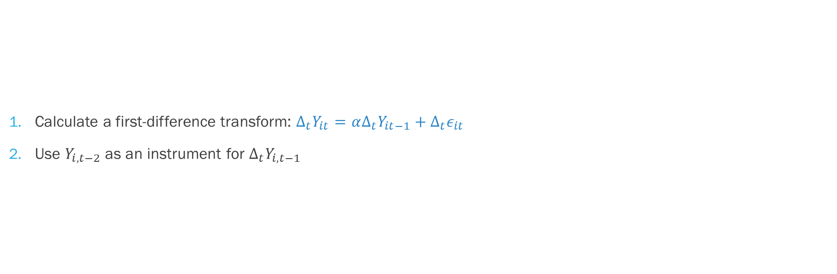

Anderson and Hsiao (1981) Use $Y_{i,t−2}$ as an instrumental variable for $Δ_{t}Y_{i,t−1}$
Calculate a first-difference transform: $Δ_{t}Y_{it}=αΔ_{t}Y_{it−1}+Δ_{t}ε_{it}$
Use $Y_{i,t−2}$ as an instrument for $Δ_{t}Y_{i,t−1}$

Slide 15
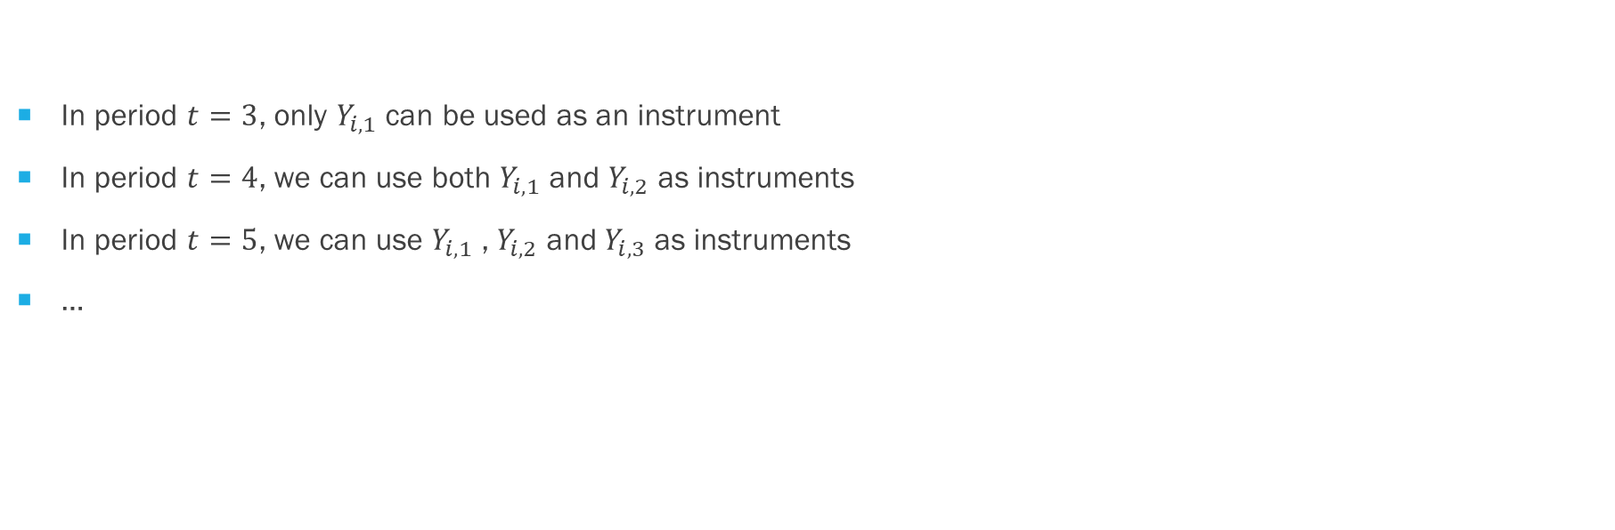
Arellano and bond (1991) use more lags as instruments
In period $t=3$, only $Y_{i,1}$ can be used as an instrument
In period $t=4$, we can use both $Y_{i,1}$ and $Y_{i,2}$ as instruments
In period $t=5$, we can use $Y_{i,1}$ ,$Y_{i,2}$ and $Y_{i,3}$ as instruments
…

Slide 16
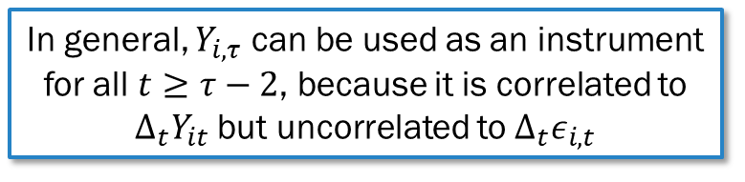
Arellano and bond (1991) use more lags as instruments
In period $t=3$, only $Y_{i,1}$ can be used as an instrument
In period $t=4$, we can use both $Y_{i,1}$ and $Y_{i,2}$ as instruments
In period $t=5$, we can use $Y_{i,1}$ ,$Y_{i,2}$ and $Y_{i,3}$ as instruments
…
In general, $Y_{i,τ}$ can be used as an instrument for all $t≥τ−2$, because it is correlated to $Δ_{t}Y_{it}$ but uncorrelated to $Δ_{t}ε_{i,t}$
What would change if $Y_{it}$ depended not only on $Y_{i,t−1}$ but also on $Y_{i,t−2}$?

Slide 17
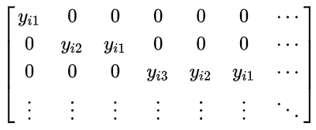
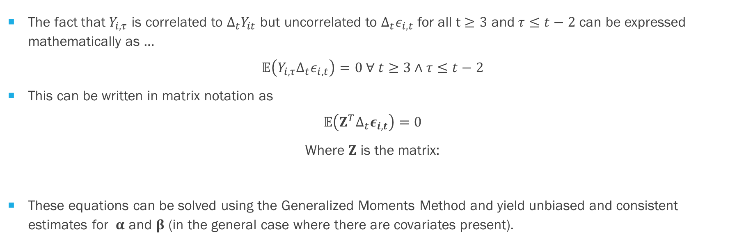
Mathematically,…
The fact that $Y_{i,τ}$ is correlated to $Δ_{t}Y_{it}$ but uncorrelated to $Δ_{t}ε_{i,t}$ for all $t≥3$ and $τ≤t−2$ can be expressed mathematically as …
$$𝔼\left(Y_{i,τ}Δ_{t}ε_{i,t}\right)=0 ∀ t≥3∧τ≤t−2$$
This can be written in matrix notation as
$$𝔼\left(Z^{T}Δ_{t}ε_{i,t}\right)=0$$
Where $Z$ is the matrix:
These equations can be solved using the Generalized Moments Method and yield unbiased and consistent estimates for $α$ and $β$ (in the general case where there are covariates present).

Slide 18
This class in 2 sentences (again ☺)
A dynamic panel data model is one where $y_{it}$ depends on passed values of $y_{i.}$, such as $y_{it−1},y_{it−2}$ etc.
When this happens, $β$ can be estimated using the Arellano-Bond (AB) GMM estimator.

